Slide 1
Class Planner
By Craig Colegrove

Slide 2
Project Goals
Offline alternative to Pirate Port
Allow users to play around with different class schedules
Give a visual chart of class times

Slide 3
Implementation
Couldn’t make it download straight from Pirate Port
Downloaded a text file of the class information
Used regex to sort through the information
Created an ArrayList of all the classes Whitworth offers and their information
Allowed the ArrayList to be sorted and searched through

Slide 4
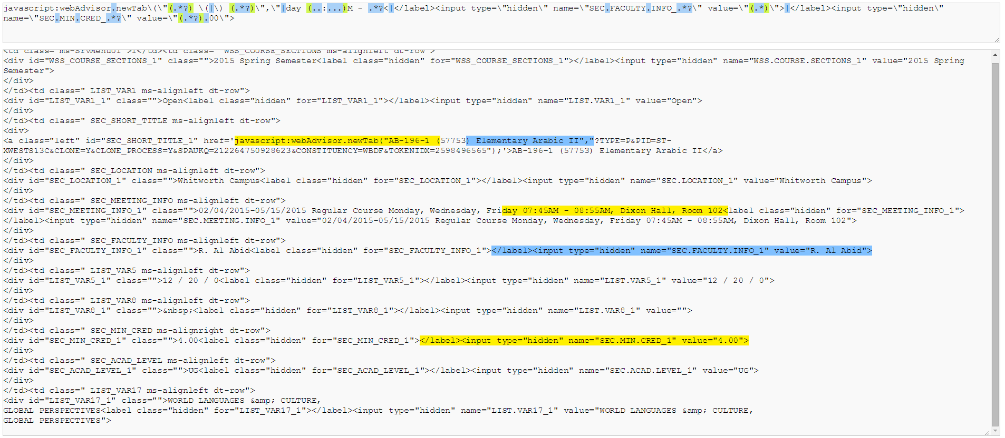
Regex Example

Slide 5
Challenges
Pirate Port limitations
Regex for credits
Intuitive UI

Slide 6
Demo

